Slide 1
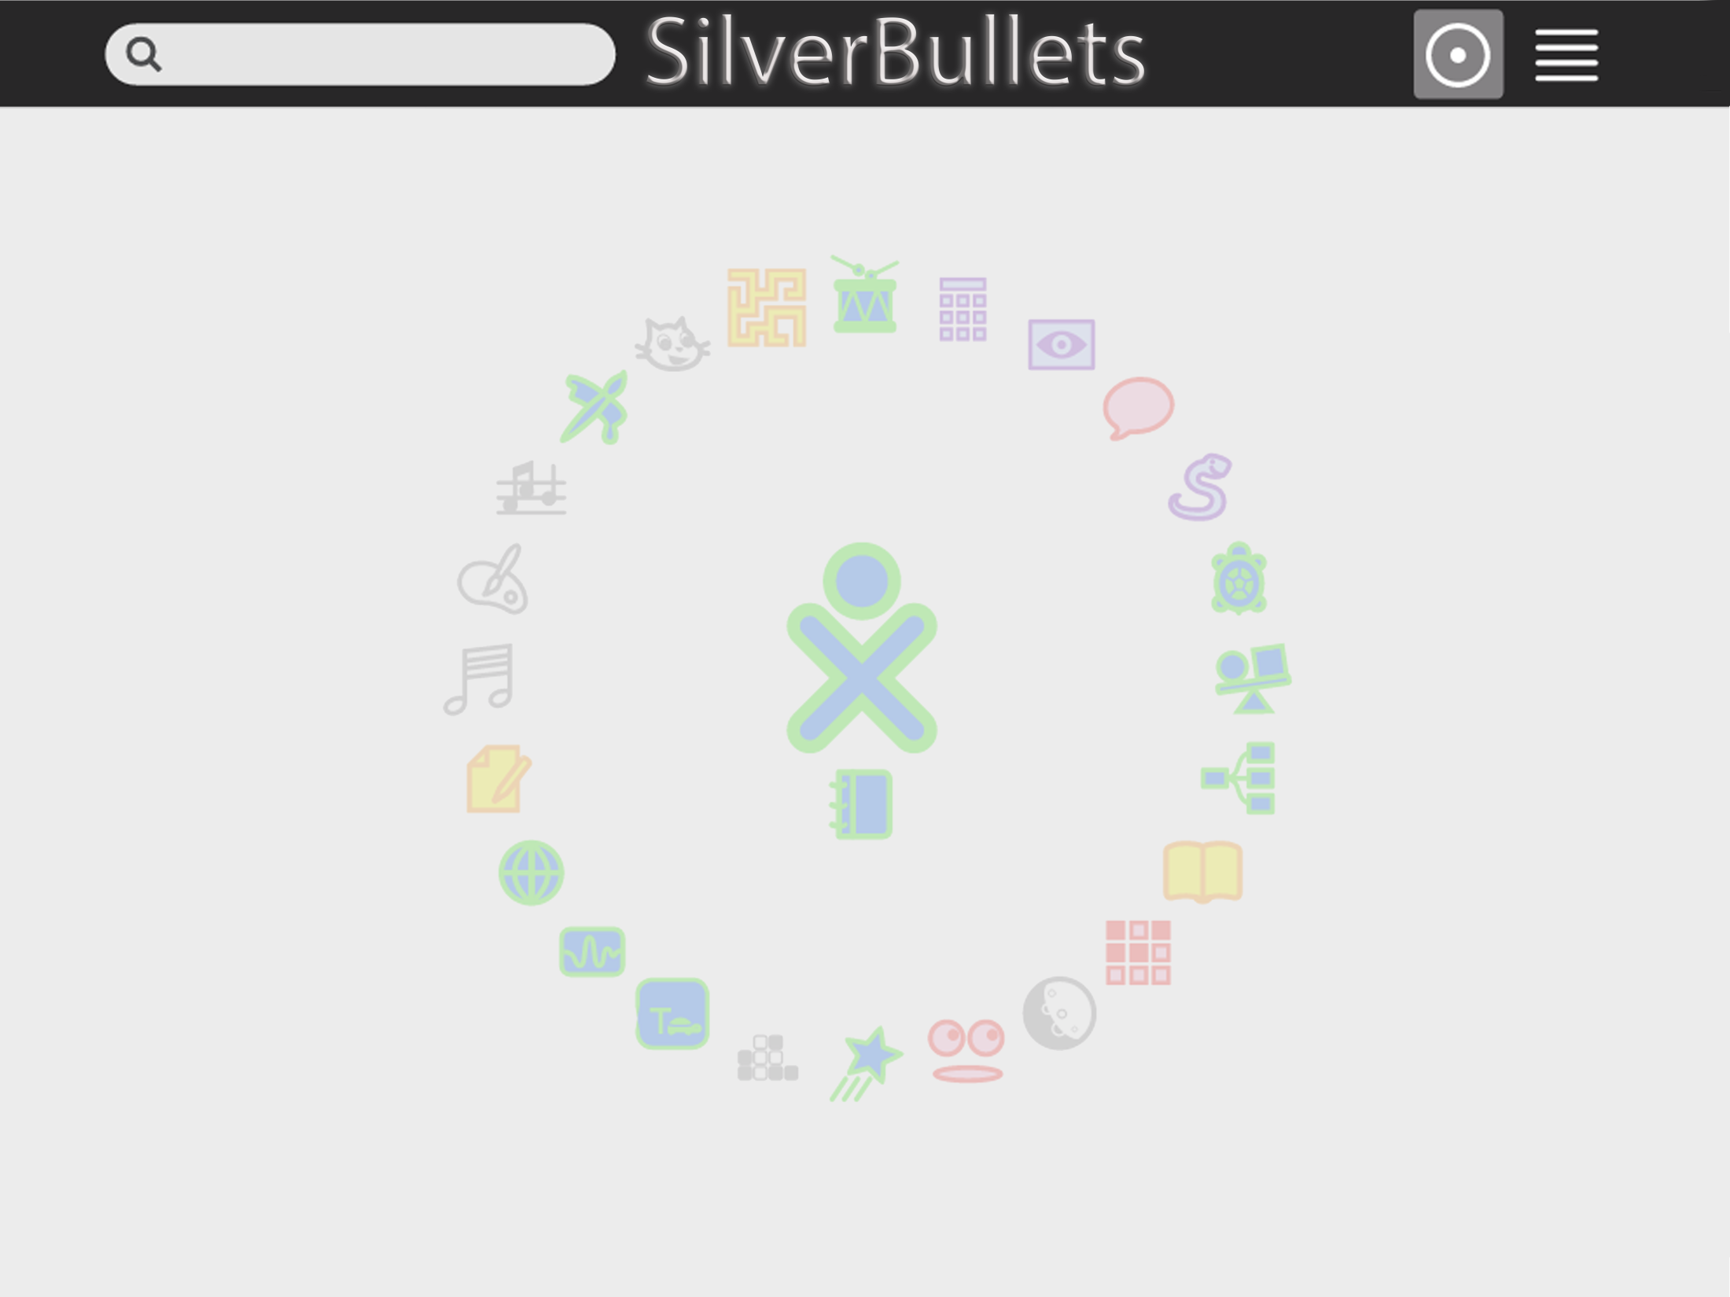
SugarLabs Testing Analysis and Framework
Jameson Burroughs, Christopher Lewis, Megan O’Neal, Alexander Wray

Slide 2

Introduction
We are Jameson Burroughs, Christopher Lewis, Megan O’Neal, and Alex Wray.
College of Charleston
Computer Science

Slide 3
What is Sugar?
Sugar is a learning platform that reinvents how computers are used for education. Collaboration, reflection, and discovery are integrated directly into the user interface. Sugar promotes "studio thinking" and "reflective practice". Through Sugar's clarity of design, children and teachers have the opportunity to use computers on their own terms. Students can reshape, reinvent, and reapply both software and content into powerful learning activities. Sugar's focus on sharing, criticism, and exploration is grounded in the culture of free software (FLOSS).

Slide 4
In Shorter Terms…
Sugar is a Linux variant designed as a teaching tool for children.
It includes multiple different activities, each written in Python.
Easy platform to write activities on as a independent developer!

Slide 5
Why We Chose Sugar
Liked the philosophy behind it.
Simple set-up and installation made testing easy.
Easily runnable and modifiable Python activities.

Slide 6
Framework Setup Overview
/scripts/ - contains main python running script, runAllTests.py
/testCases/ - contains text files detailing each test case. Holds information to be passed
/project/src/ - location of the python Calculator activity that is being tested
/oracles/ - contains text files with expected outcomes of each test case
/testCaseExecutables/ - contains the python executable files to run each test case
/reports/ - contains the HTML file containing the aggregated result information
/Outputs/ - contains text files of test case executable results after the program is run

Slide 7
/scripts/ & /project/src
The scripts folder contains our main python script.
We will go into more detail about the script in a bit.
Script is currently configured to run with python2.
The /project/src folder holds the python class that we are testing.

Slide 8
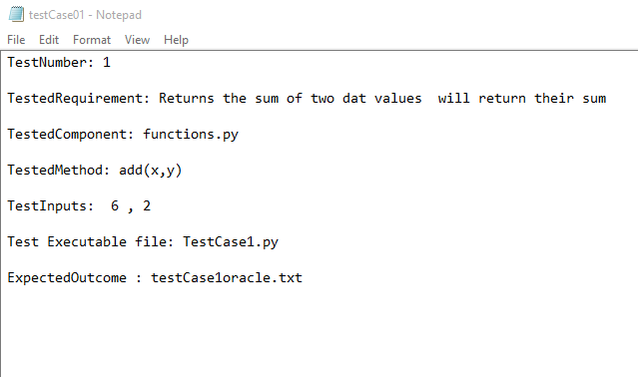
/testCases/
Contains text files detailing each test case.
These hold the information that is to be passed when methods are tested.
Example:

Slide 9
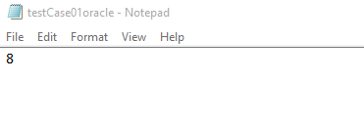
/oracles/
Contains files with expected outcomes.
Different file for each test we plan on running.
Example:

Slide 10
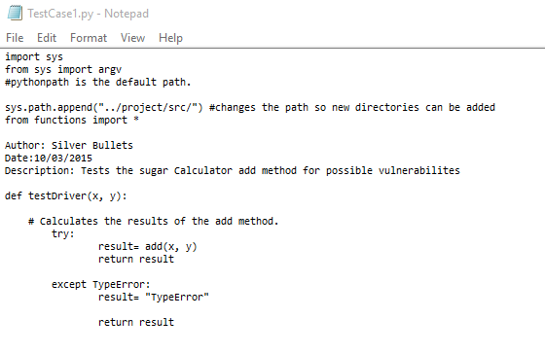
/testCaseExecutables/
This folder contains the individual scripts for each test case, detailing potential error catches and the method to be tested.
Example:

Slide 11
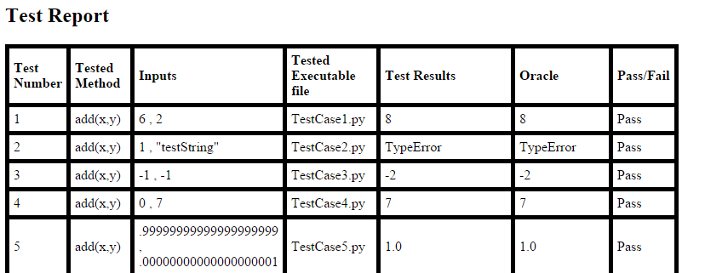
/reports/
This contains the HTML file that runs as a result of our main script.
Here’s a snippet of what it looks like.

Slide 12
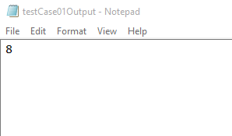
/Outputs/
The Outputs folder contains text files created after running our main script.
Each of these are compared to their respective oracles in order to determine a pass or fail.

Slide 13
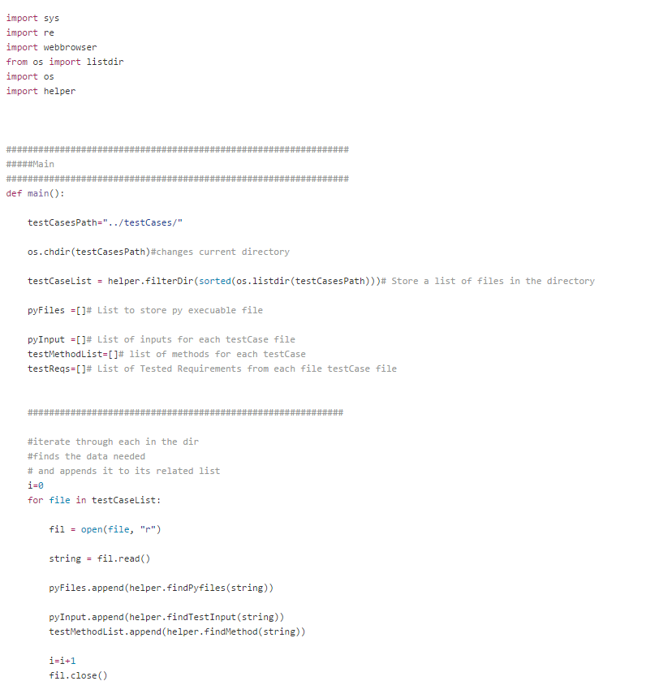

Slide 14
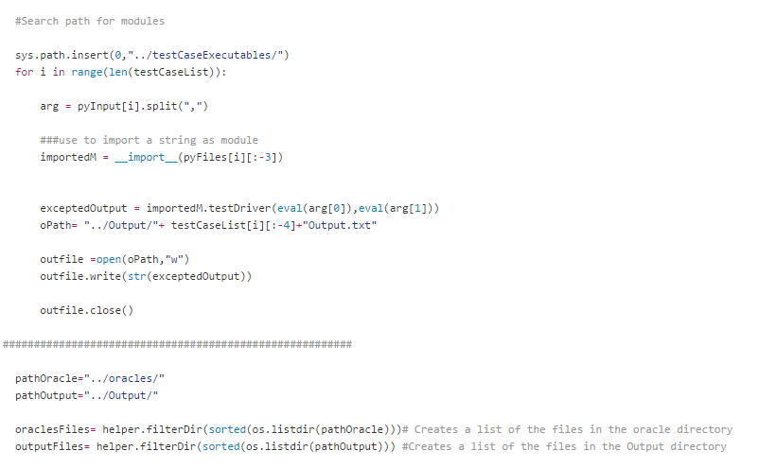

Slide 15
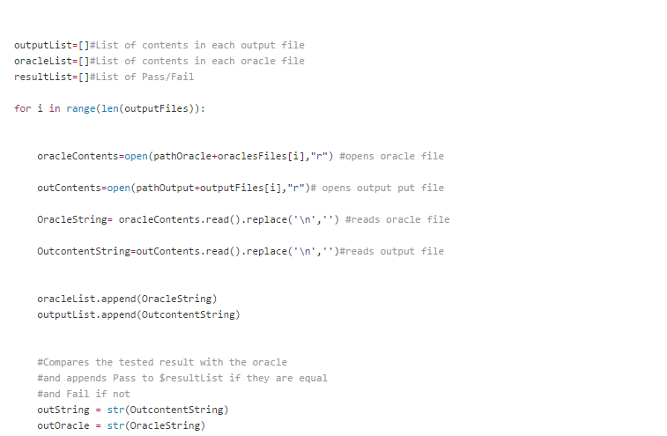

Slide 16
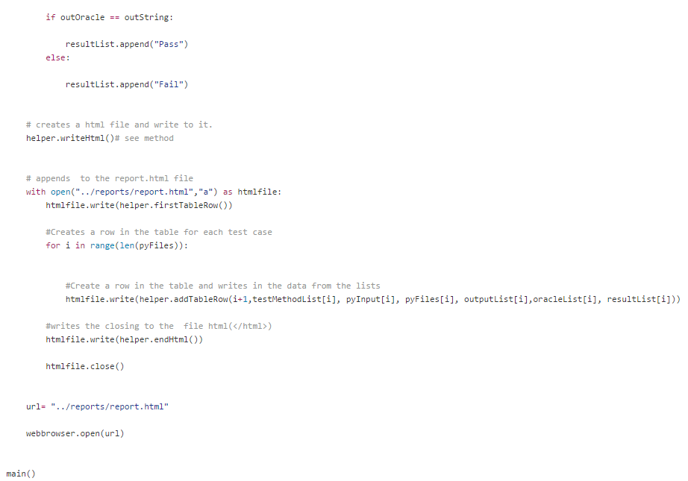

Slide 17
Injecting Faults
Our team added one fault for each of the five methds, since five faults were needing to be injected!

Slide 18
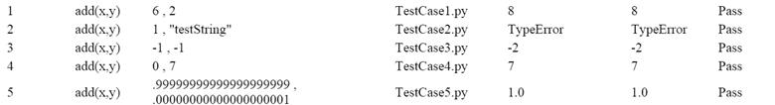
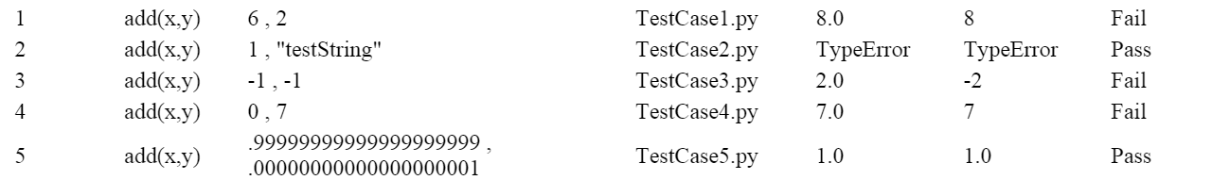
Fault #1 - add(x,)
#fault inserted: added abs method to return value return abs(x + y)

Slide 19
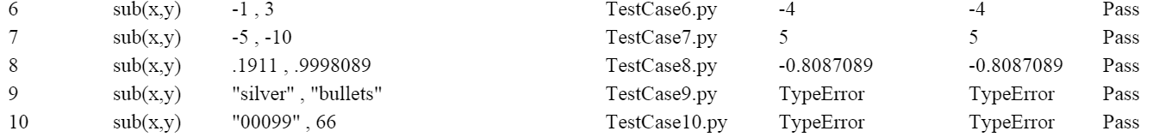
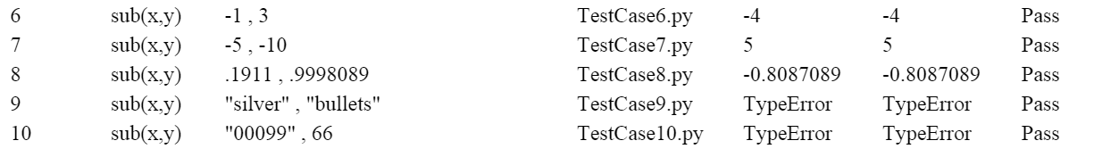
Fault #2 - sub(x,y)
#fault inserted: took away if statement so it would not convert values to decimals. #if isinstance(x, _Decimal) or isinstance(y, _Decimal): # x = _d(x) # y = _d(y) return x - y

Slide 20
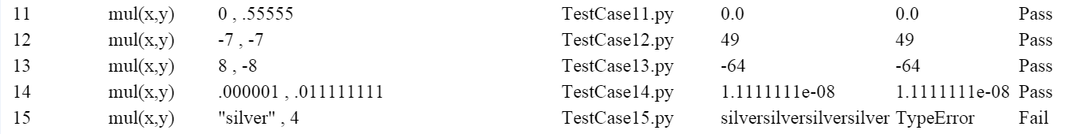
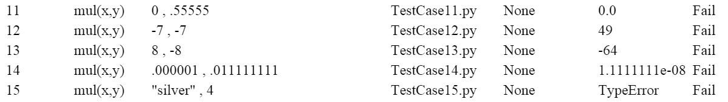
Fault #3 – mul(x,y)
if isinstance(x, _Decimal) or isinstance(y, _Decimal): x = _d(x) y = _d(y) #fault inserted: indented return statement. return x * y

Slide 21
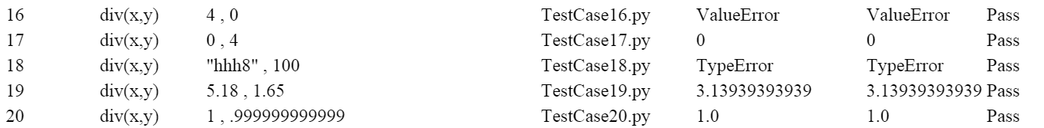
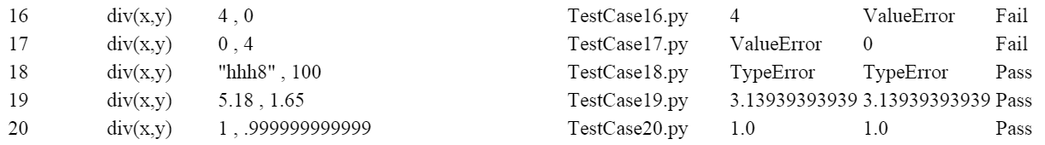
Fault #4 – div(x,y)
if x == 0 or x == 0.0:#fault insert changed y to x

Slide 22
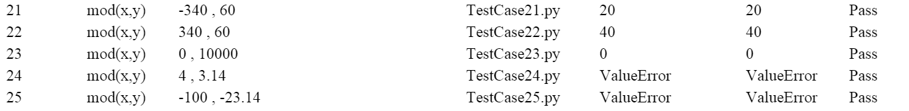
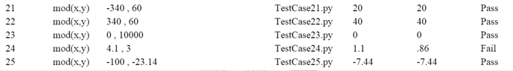
Fault #5 – mod(x,y)
#if is_int(y): return x % y #else: #raise ValueError(_('Can only calculate x modulo <integer>'))

Slide 23
What we all learned
Jameson Burroughs
Teamwork
Independent Learning

Slide 24
What we all learned
Christopher Lewis
“Working as a self-guided team showed me the importance of creating project milestones. Without required deliverables, our team would have certainly fallen behind schedule. Working with the deliverable guidelines allowed us to schedule fairly regular team meetings to hash out both technical problems and organizational requirements. Management of time and resources are vital to the success of a project that includes multiple steps. Hurrying to get it done would have spelled disaster for us! If I had to change one thing about the project, I’d write slightly clearer instructions for the specifications required for our testing automation framework. We had to go back and change our structure and functionality a few times to meet the specifications.”

Slide 25
What we all learned
Megan O’Neal
“I learned that deliverables are necessary with group projects because they hold people accountable and people work better under a least a little pressure. Documentation is important when explaining yourself and giving yourself credibility. Also, assigning roles are necessary to hold people responsible and give credibility, but these roles may change as you go and you have must be flexible.”

Slide 26
What we all learned
Alexander Wray
On the programming side I learned the basics of bash/Linux and how to interact with the command panel to get it to do things, I also dusted off my python knowledge some and in relation to this learned just how quickly you can forget the form of a language if you get too used to using another language. Aside from programming I learned that making sure everyone, in a group, feels like they are getting meaningful and fulfilling jobs can sometimes be difficult, especially if the main task at hand is something fairly easy, but has to be complete before other work can be done. Another important lesson of this project was if it doesn't work sometimes scraping and starting over is a better approach, this was apparent in our script which was giving us trouble in Linux, but ended up working well in python. One of the things this project made me question the most outside of programming problems is team numbers for our assignment 4 people worked, but it could have been done with less, however what I really think is an interesting problem is how to tell the optimal number of people for a task, because if our class had chosen five members per team there would have inevitably been a lack of work for at least one or two people.

